Slide 1
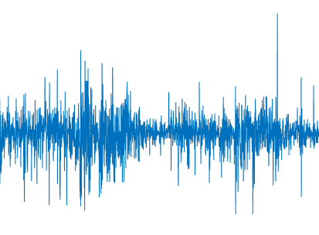
GARCH:
How insights on conditional variance can help our predictions
Francisco Pitthan

Slide 2
Problems
OBJECTIVE
a

Slide 3
Problems
EXECUTIVE SUMMARY
a

Slide 4
Problems
STATIONARITY ASSUMPTION
a

Slide 5
Problems
EXAMPLE:
MONTE CARLO
(symmetric distribution)
a

Slide 6
Problems
PRICE
REALITY OF
FINANCIAL TIME SERIES
a

Slide 7
Problems
RETURN
REALITY OF
FINANCIAL TIME SERIES
a

Slide 8
Problems
RETURN
REALITY OF
FINANCIAL TIME SERIES
a

Slide 9
a

Slide 10
a
2. a

Slide 11






Motivation
a

Slide 12

a
a

Slide 13
THANK YOU!!
GARCH:
How insights on conditional variance can help our predictions
Francisco Pitthan

